Slide 1

DSCI 6004 - 01 Natural Language Processing
By
Saikrishna Chigicherla
Pavan Teja Sripati

Slide 2
Multilingual Video Synopsis Generator English Video Summarization in Multiple Languages

Slide 3
Outline
Statement of project objectives
Statement of value
Overview
Approach
Evaluation
References

Slide 4
Objectives
Develop a model to convert an English video into multilingual concise summaries.
Create a web application to extract and summarize content from YouTube transcripts, improving content comprehension.
Comparing the performance(via Rouge score, Human evaluation) of the Transformers model based on summarized text.

Slide 5
Statement of Value
The purpose of summarization is to create a brief version of a source transcript while preserving its essence and essential information.
summary can substantially lessen the effort required to comprehend extensive text volumes.

Slide 6
Multilingual Summarization
Multilingual video summarization is a cutting-edge technology that revolutionizes content accessibility and understanding across diverse linguistic landscapes.
Multilingual video summarization enables the extraction of key insights and highlights from videos in various languages.
This innovative approach not only facilitates cross-cultural communication but also enhances content consumption for global audiences, making information more accessible and comprehensible regardless of language barriers.

Slide 7
Dataset & Summarization models
Datasets:
We have used YouTube videos as our dataset.
Our project takes the URL as input and process it for text summarization.
Summarization models:
BART and mBART models are used for abstractive summarization which are capable of handling multilingual text summarization.
They can concise the large transcribed texts into short summaries more human like manner.

Slide 8
Approach
YouTube Video URL
Transcribe Audio to text
Preprocessing
Translate to Arabic and French
Feed the model
Convert to Audio
Evaluation
Web Deployment

Slide 9
Evaluation
We perform ROUGE score on the text summary. This score gauge the similarity between generated and reference summaries, indicating summary quality.
Manual evaluation is done by comparing generated and reference summaries.

Slide 10
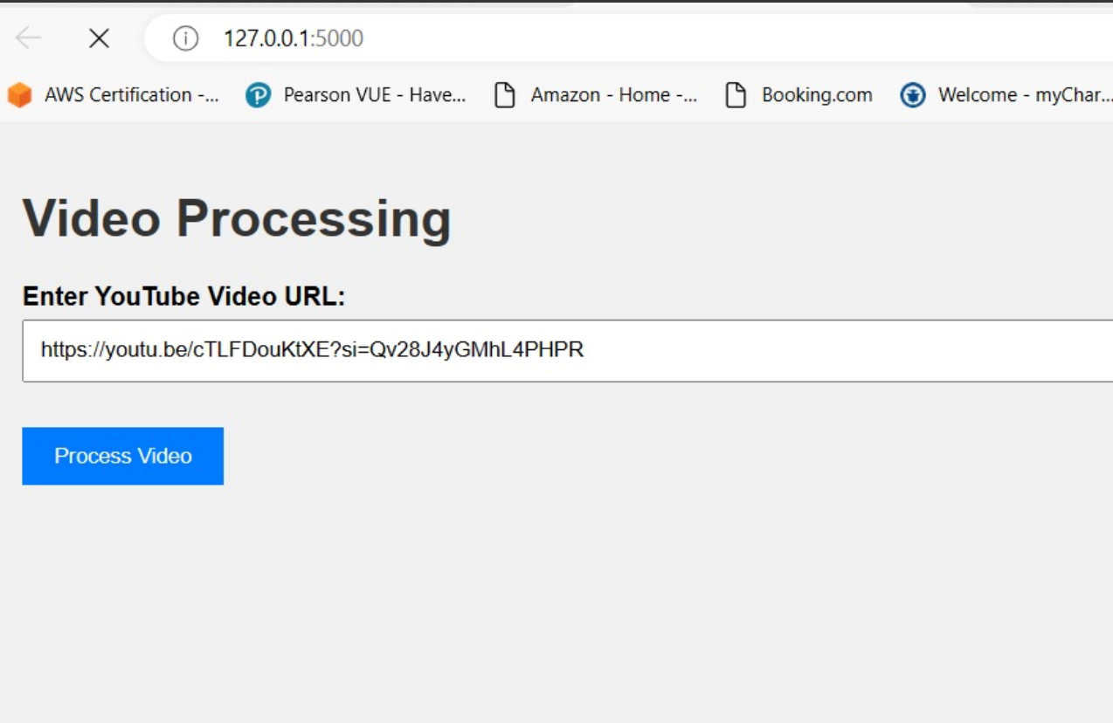
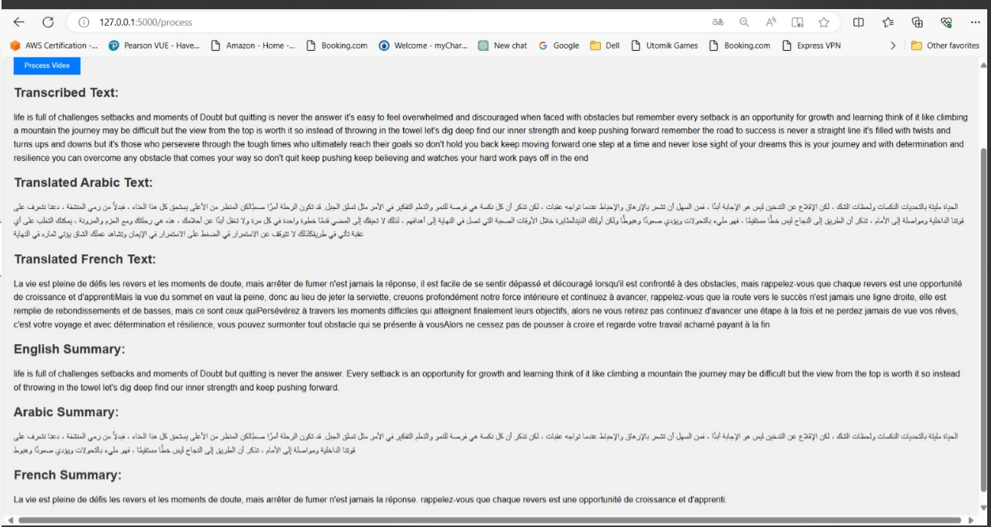
Web Application

Slide 11
References
Lin, Chin-Yew and E.H. Hovy 2003. Automatic Evaluation of Summaries Using N-gram Co-occurrence Statistics. In Proceedings of 2003 Language Technology Conference (HLT-NAACL 2003), Edmonton, Canada, May 27 - June 1, 2003.
Lin, Chin-Yew. 2004. ROUGE: a Package for Automatic Evaluation of Summaries. In Proceedings of the Workshop on Text Summarization Branches Out (WAS 2004), Barcelona, Spain, July 25 - 26, 2004.
M. Gambhir and V. Gupta, “Recent automatic text summarization techniques : a survey,” Artif. Intell. Rev. Springer Sci. Media Dordr., vol. 47, no. 1, pp. 1–66, 2016
Adhika Pramita Widyassari, Supriadi Rustad, Guruh Fajar Shidik, Edi Noersasongko, Abdul Syukur, Affandy Affandy, De Rosal Ignatius Moses Setiadi, “Review of automatic text summarization techniques & methods", Journal of King Saud University 2022
Khilji, Abdullah & Sinha, Utkarsh & Singh, Pintu & Ali, Adnan & Pakray, Dr. Partha "Abstractive Text Summarization Approaches with Analysis of Evaluation Techniques", Computational Intelligence in Communications and Business Analytics 2021

